Slide 1



Your First Step
Mobile Devlopment
Why Flutter?
Dart!
OOP

Slide 2


Table Of Contents
2.
Dart
Intro to Mobile Development
3.
OOP Implemented
1.

Slide 3
1.
Intro to Mobile Development

Slide 4
Native Dev.
Creating applications for one operating system.
Android
IoS
with
Java
or
Kotlin
with
Swift
or
Objective C

Slide 5
Disadvanteges?

Slide 6
Cross-Platform Dev.
Creating one application with one single codebse to work on multiple operating systems.

Slide 7

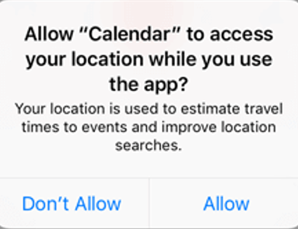
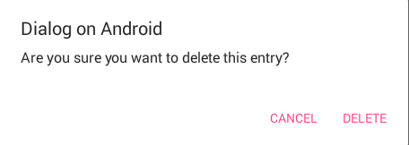
Every thing in Flutter is a Widget

Slide 8
2.
Dart

Slide 9
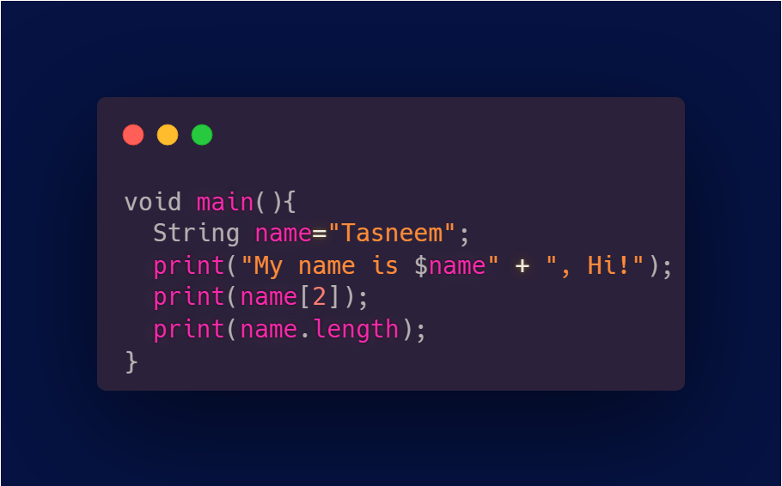
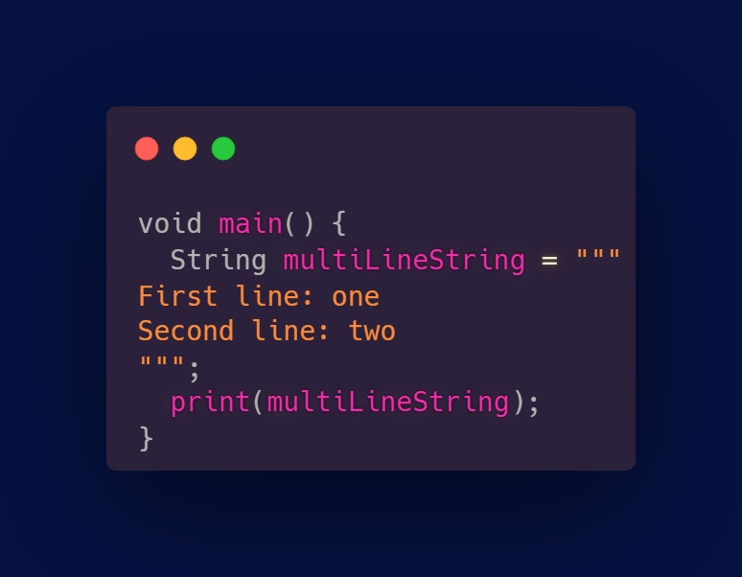
Data Types
String

Slide 10
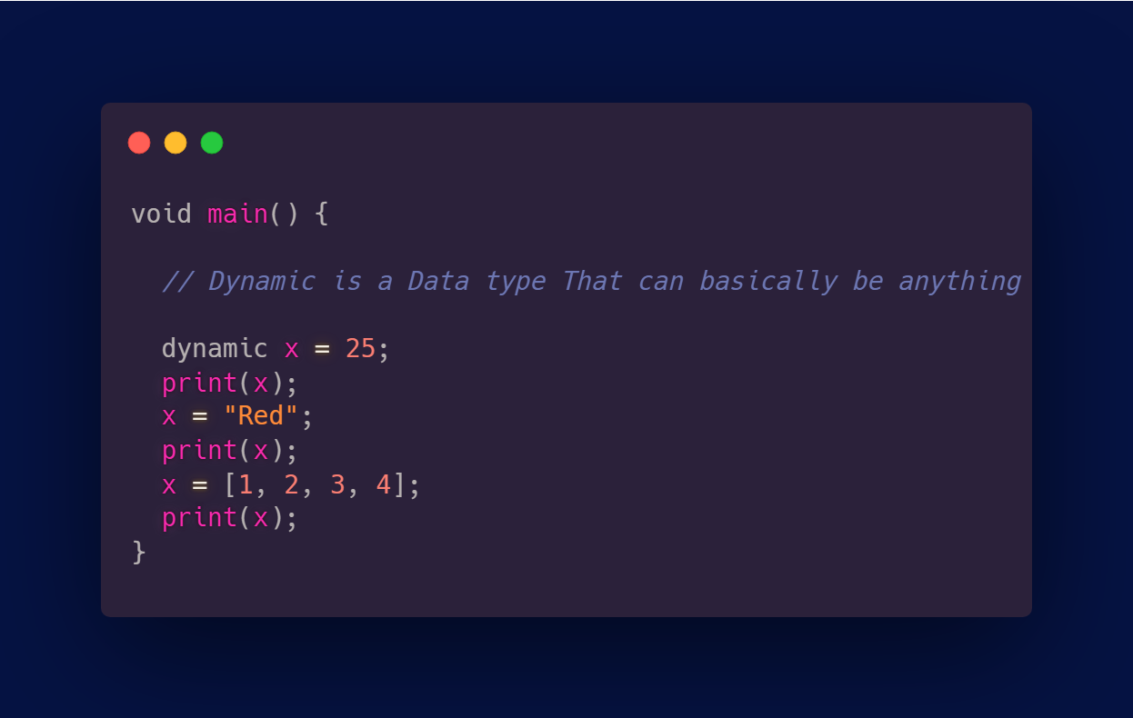
Data Types
Dynamic

Slide 11
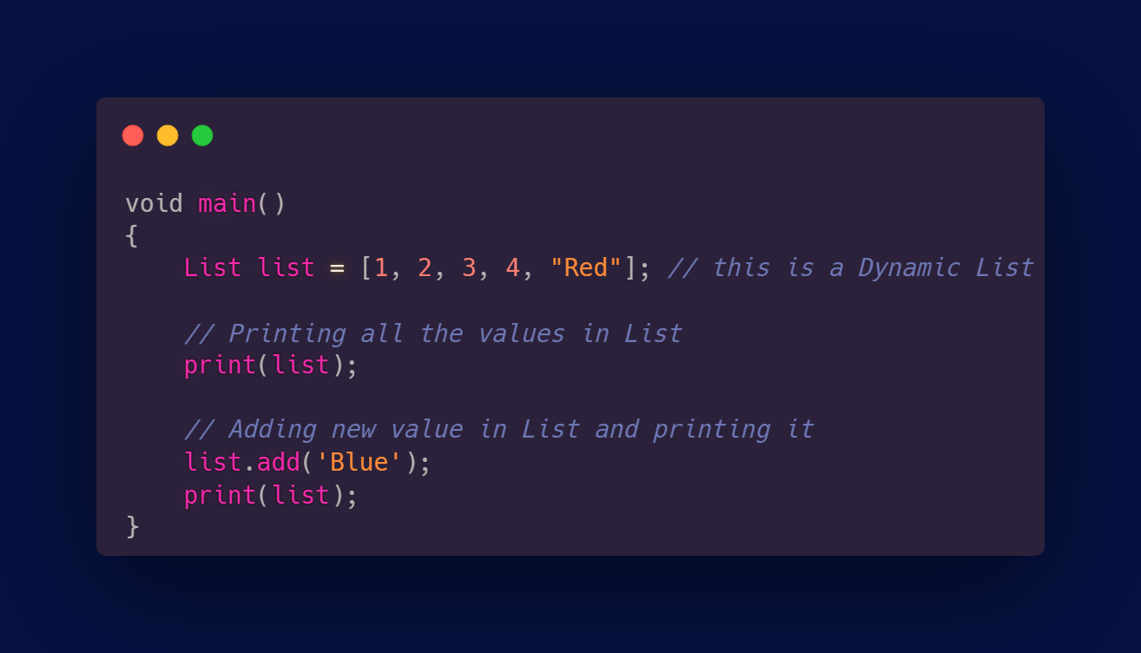
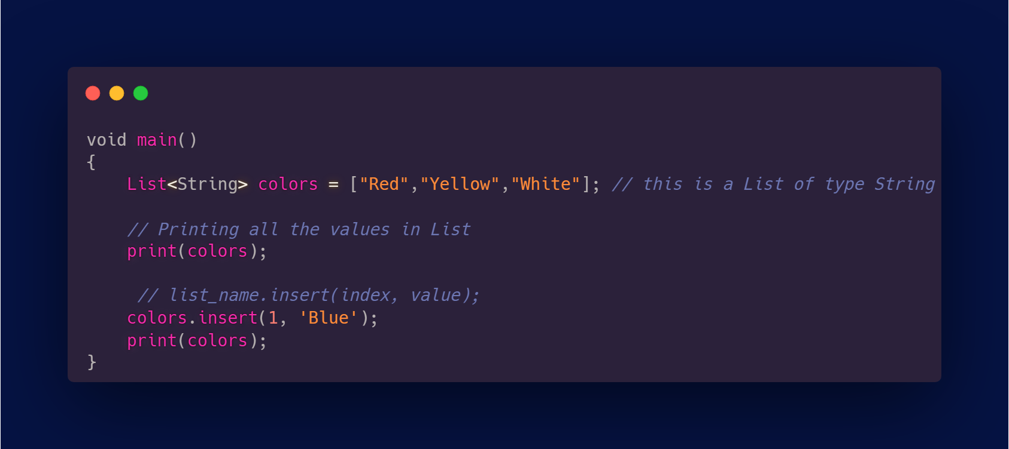
Data Types
Lists

Slide 12
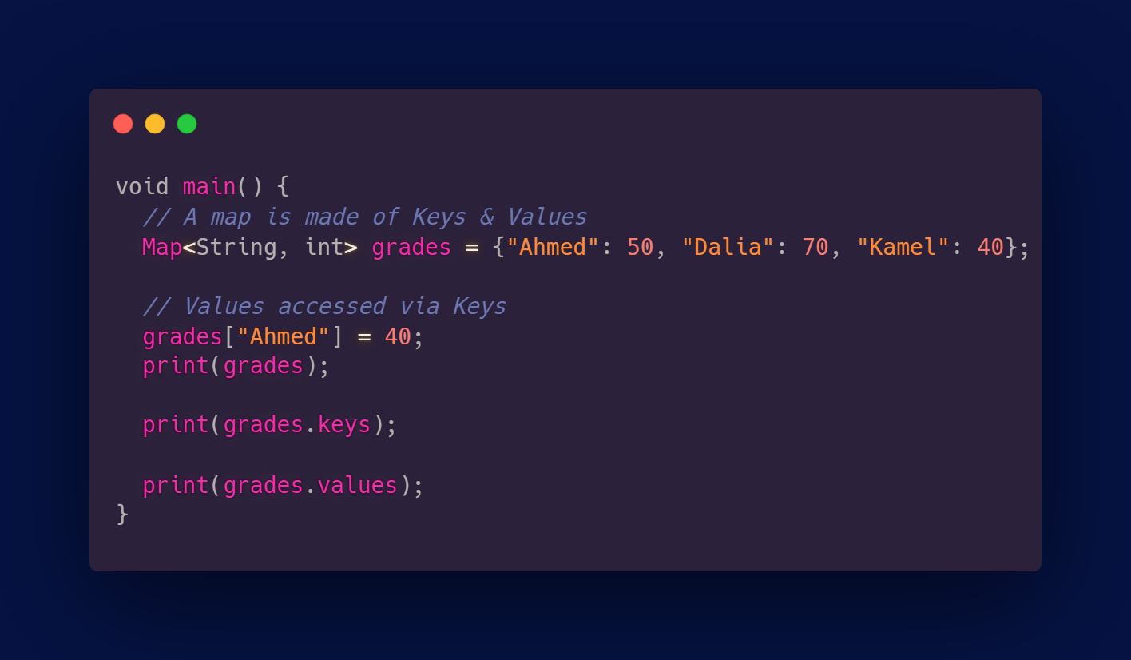
Data Types
Map

Slide 13
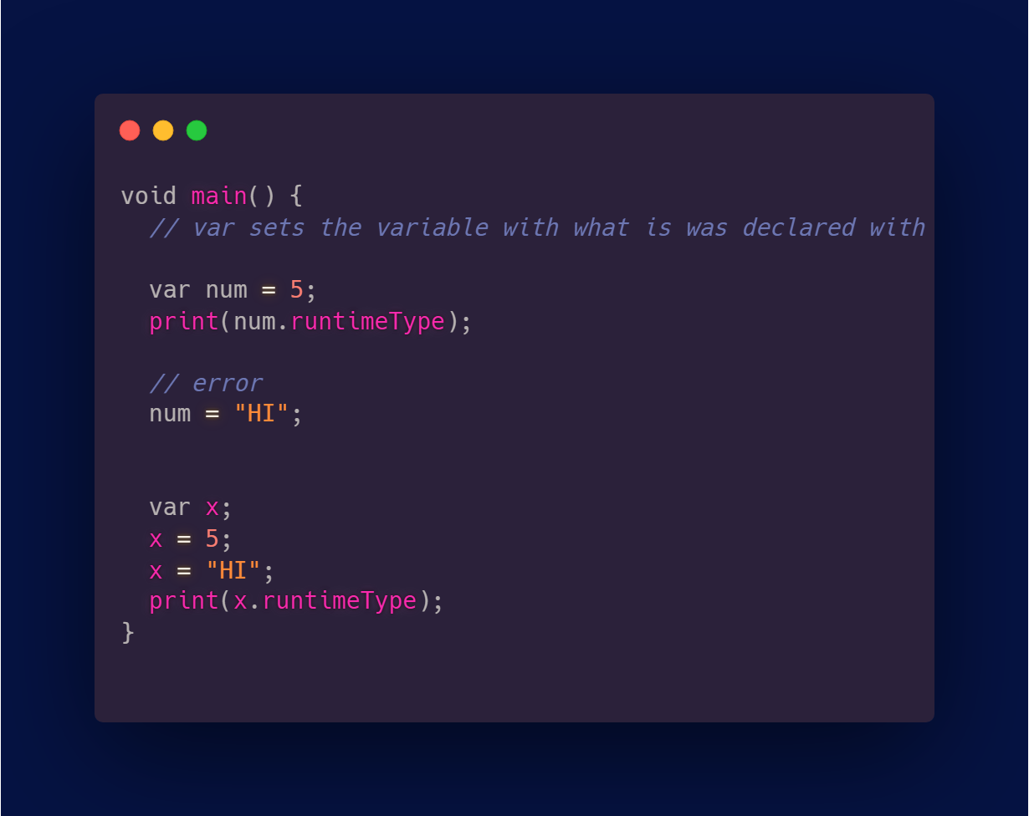
Var

Slide 14
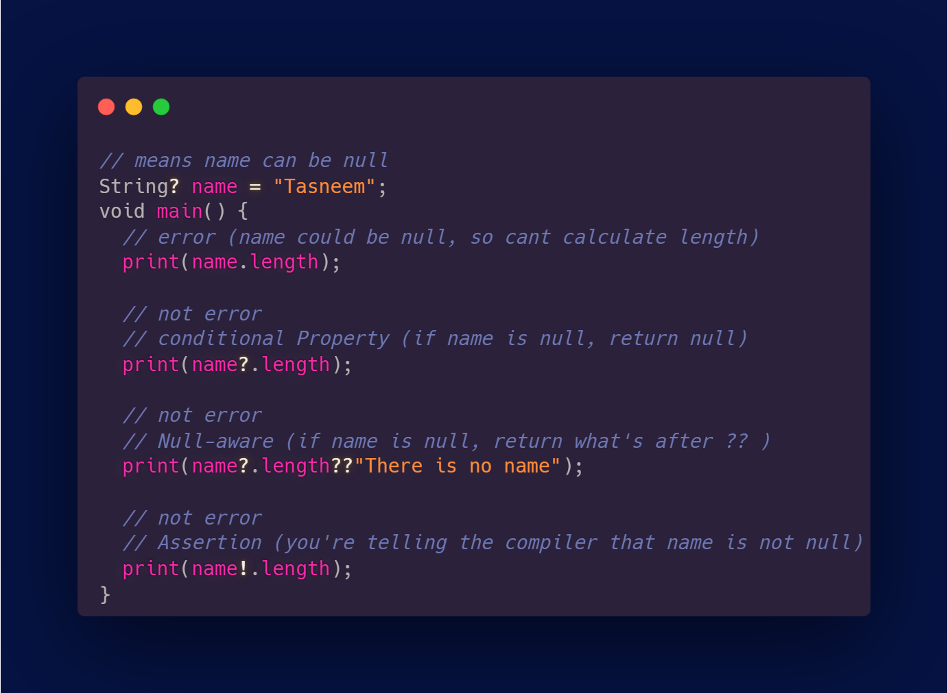
Null Safety

Slide 15
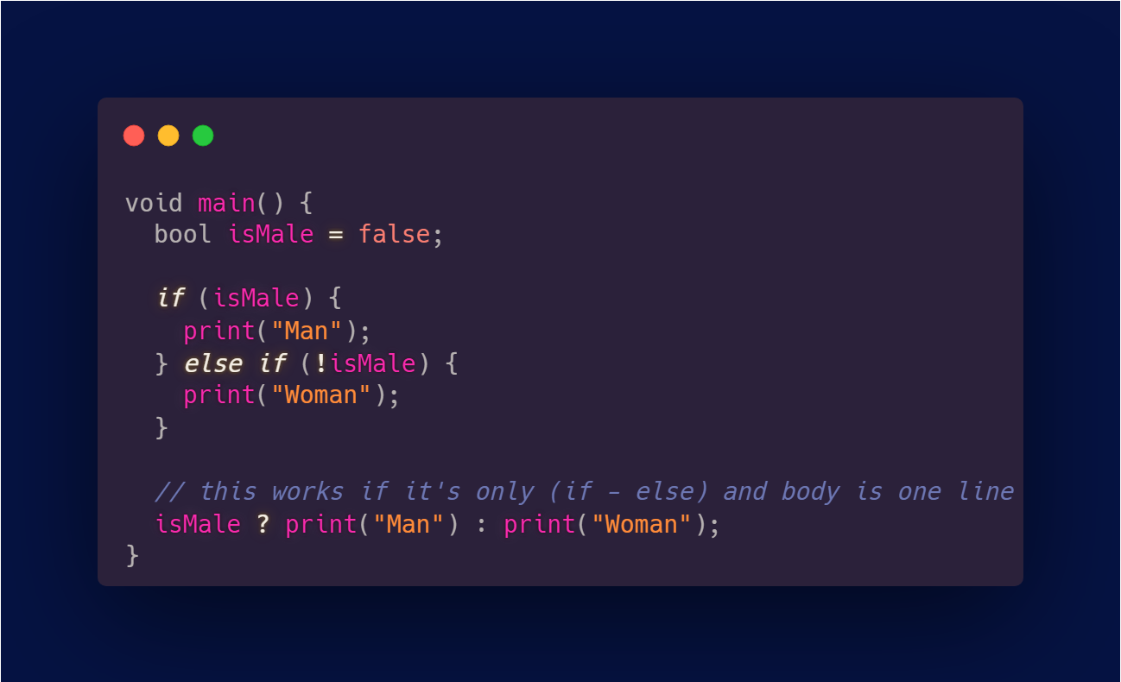
If condtion

Slide 16
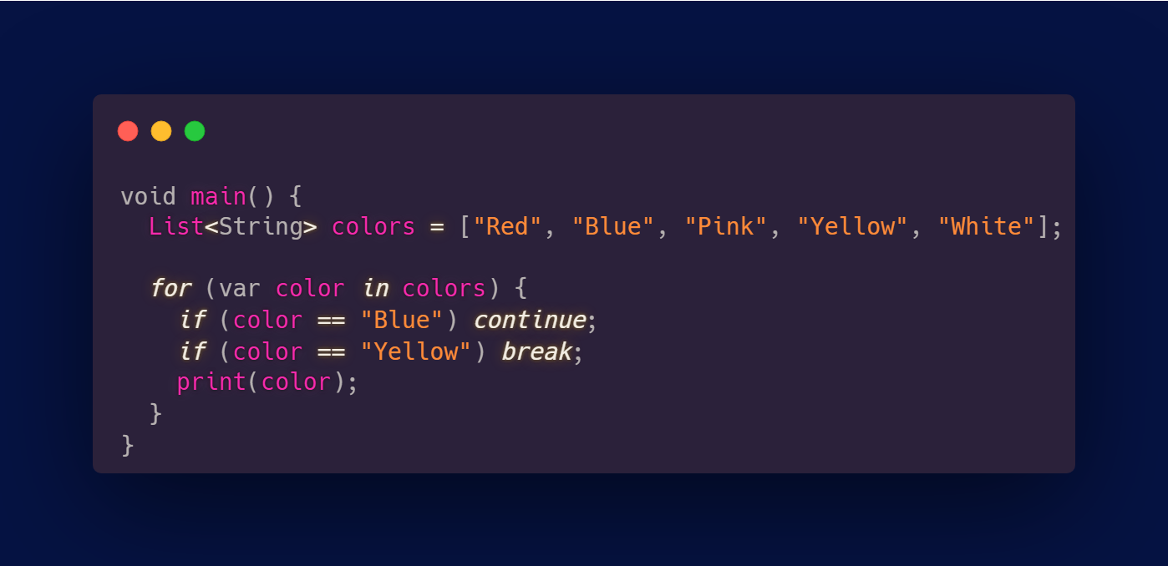
For in Loop

Slide 17
Hands on
Write a program that:
1. Has a List of Students names.
2. Has a map of student’s grades.
3. Use a for-in loop to: -> Print each student’s name & grade. -> if the grade is >= 50 print “Passed”, else “Failed”. -> if the student’s name is “Ali”, skip his display.
4. Count how many students passed.

Slide 18
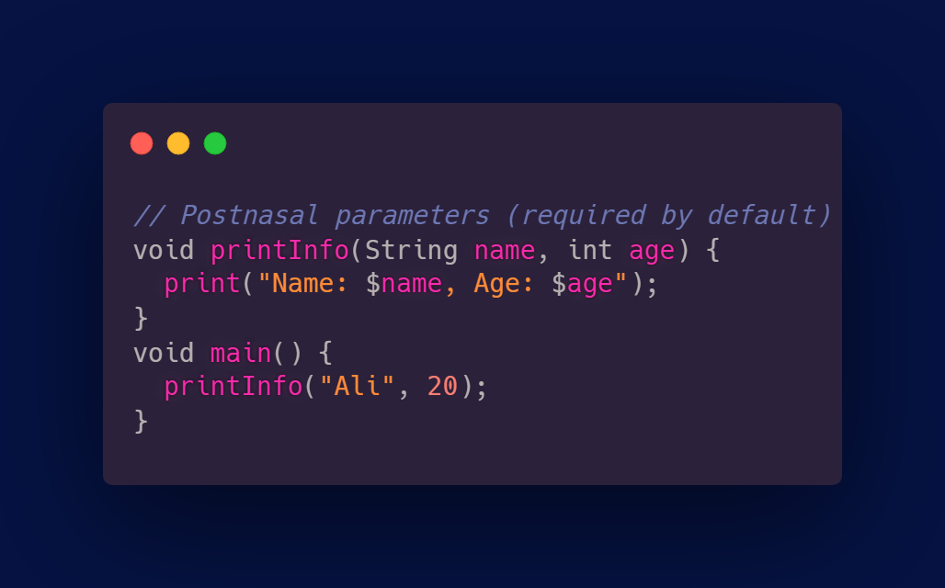
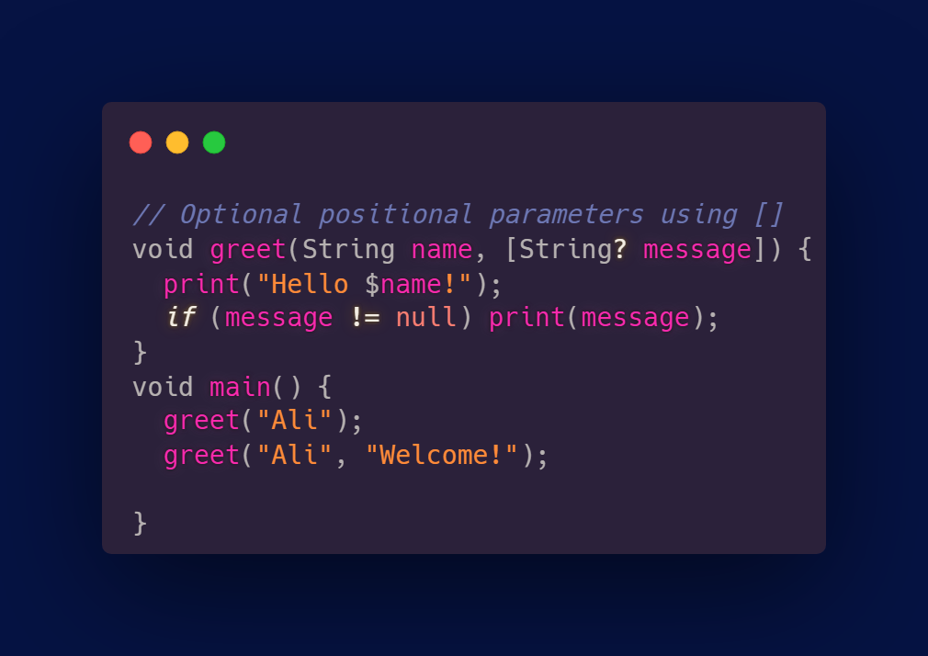
Functions

Slide 19
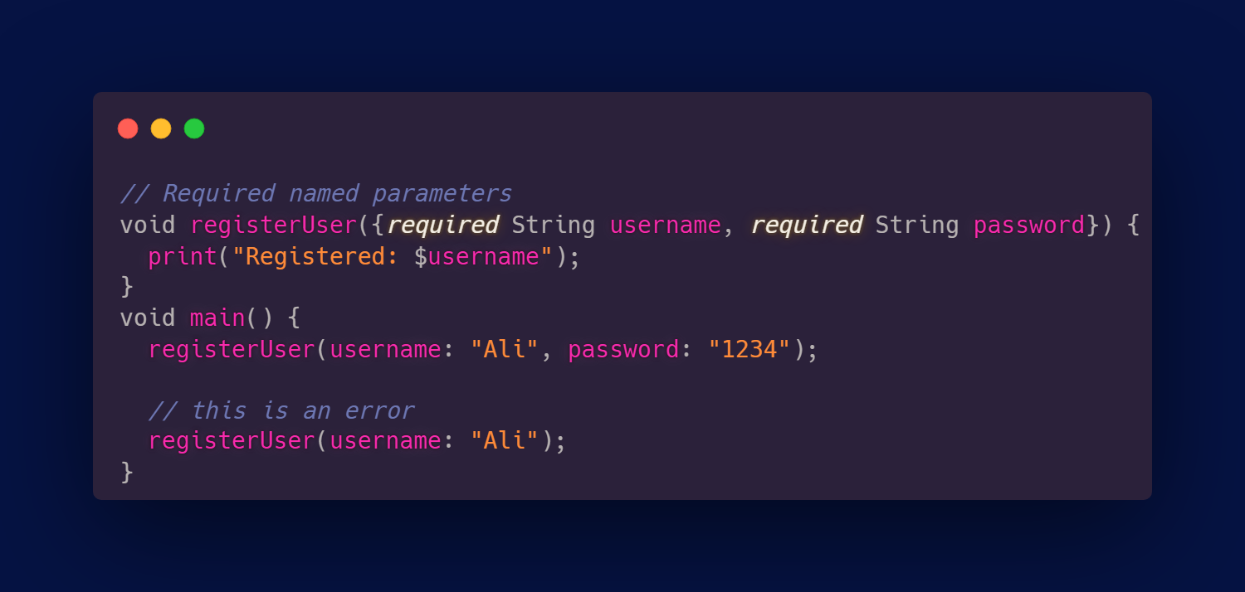
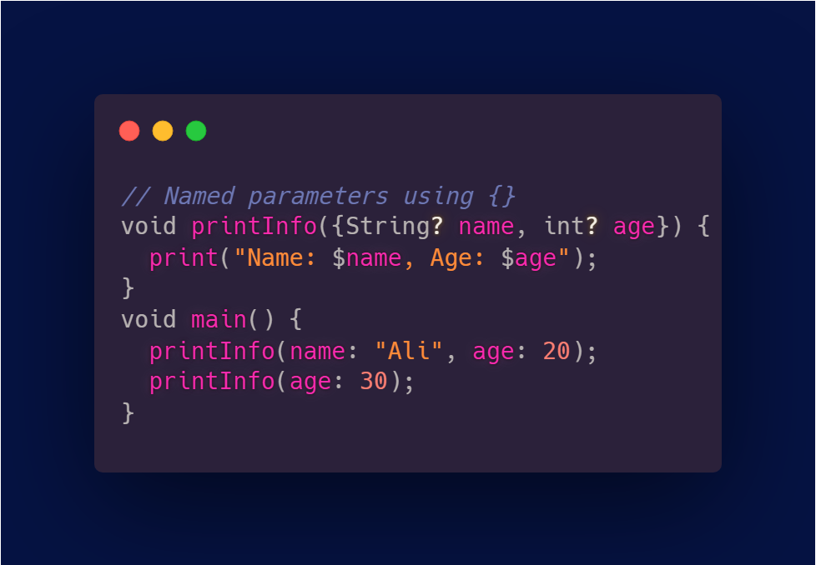
Functions

Slide 20
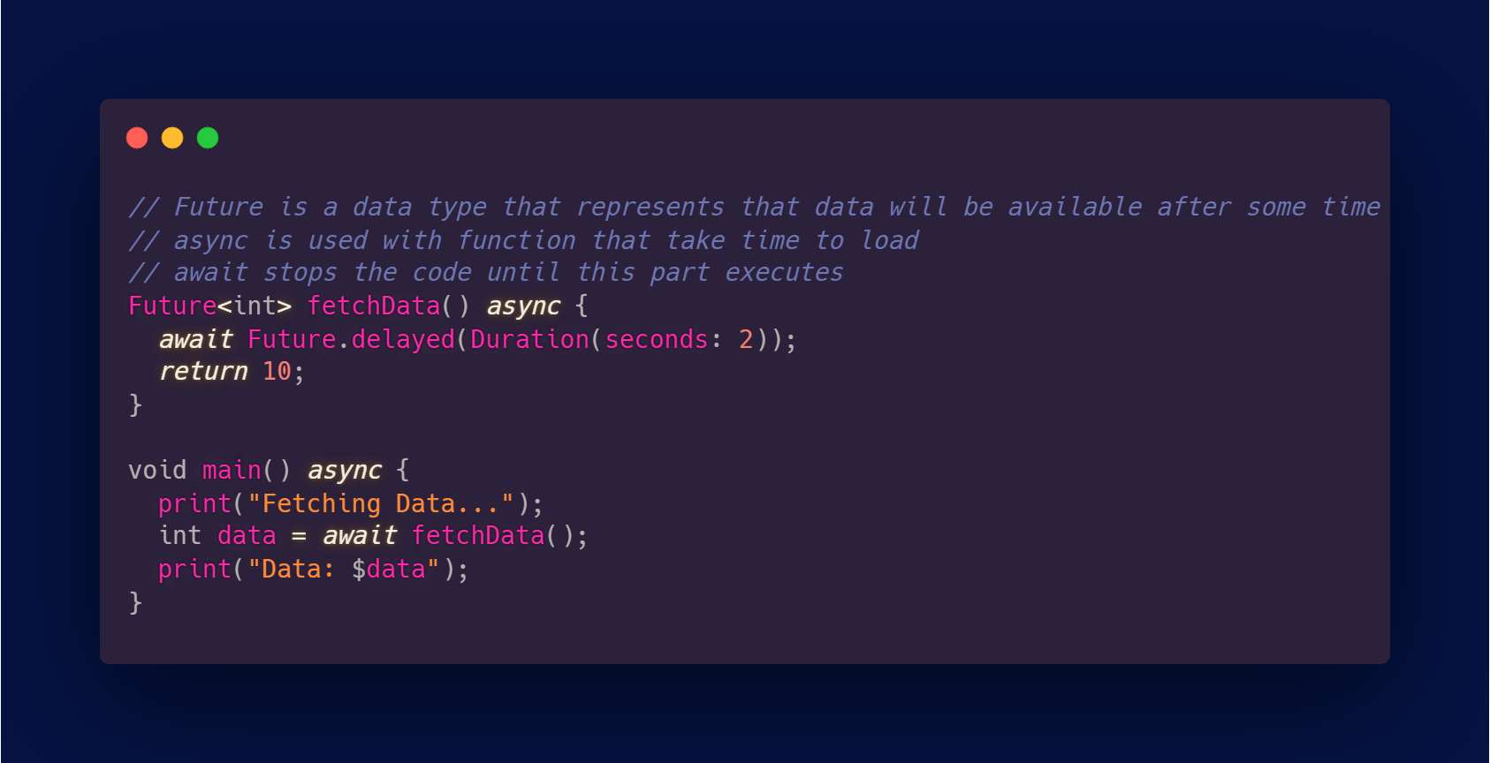
Asynchronous

Slide 21
3.
OOP Implemented

Slide 22
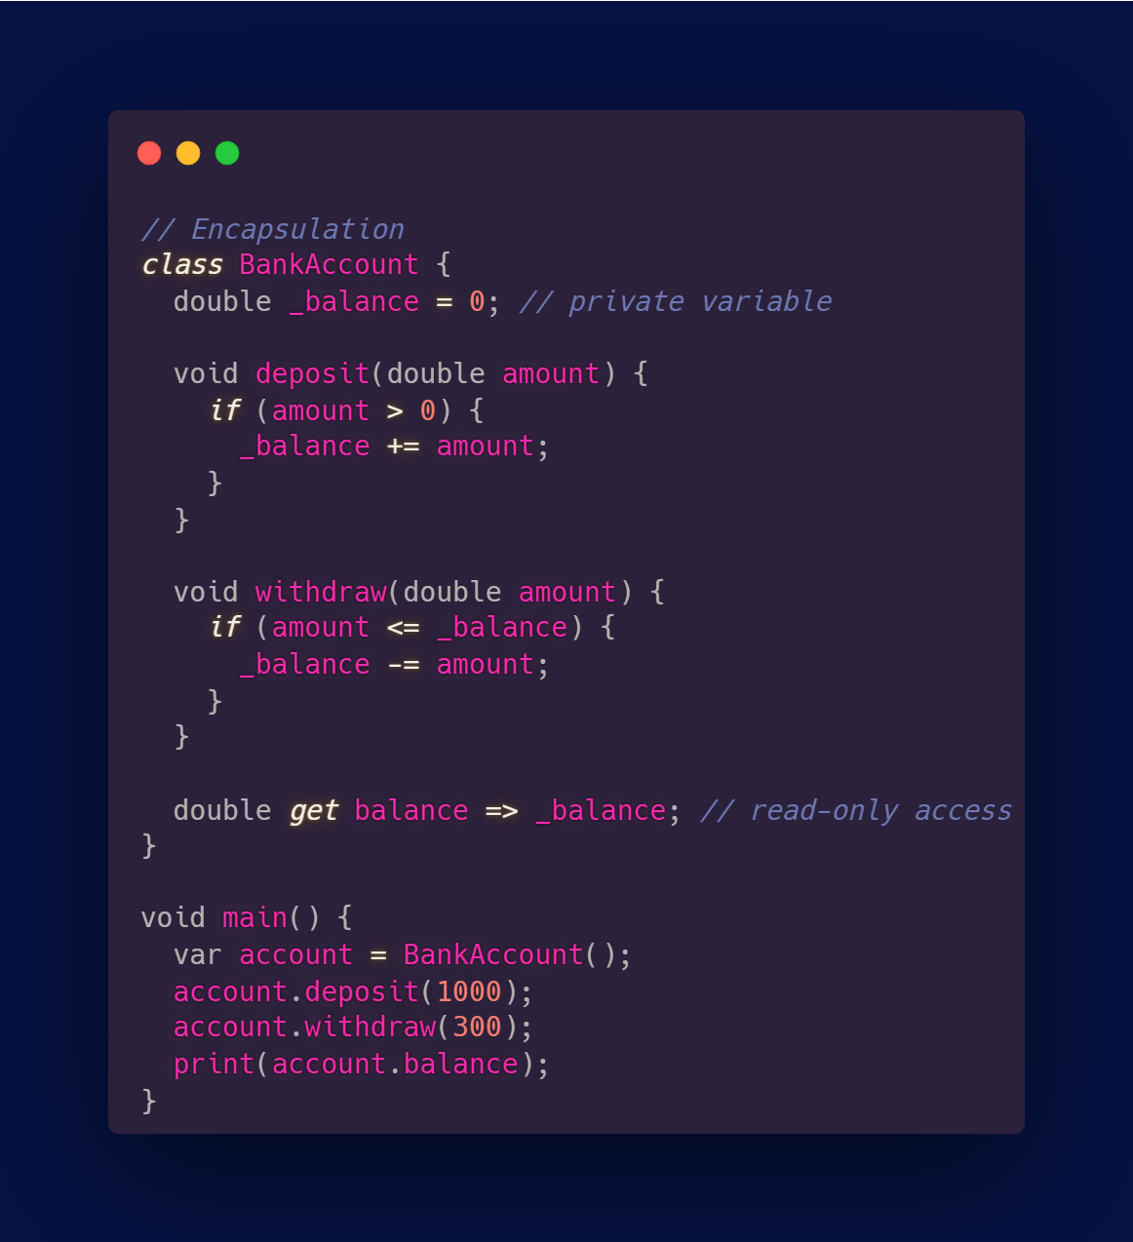
Encapsulation

Slide 23
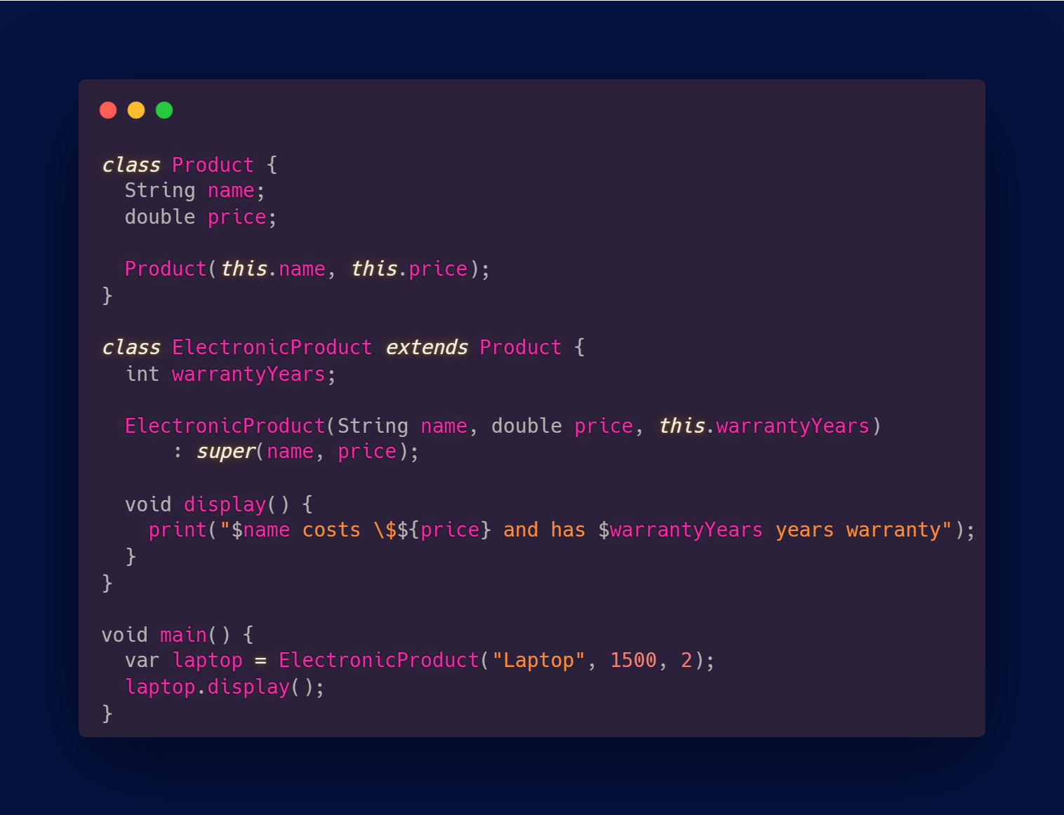
Inheritance

Slide 24
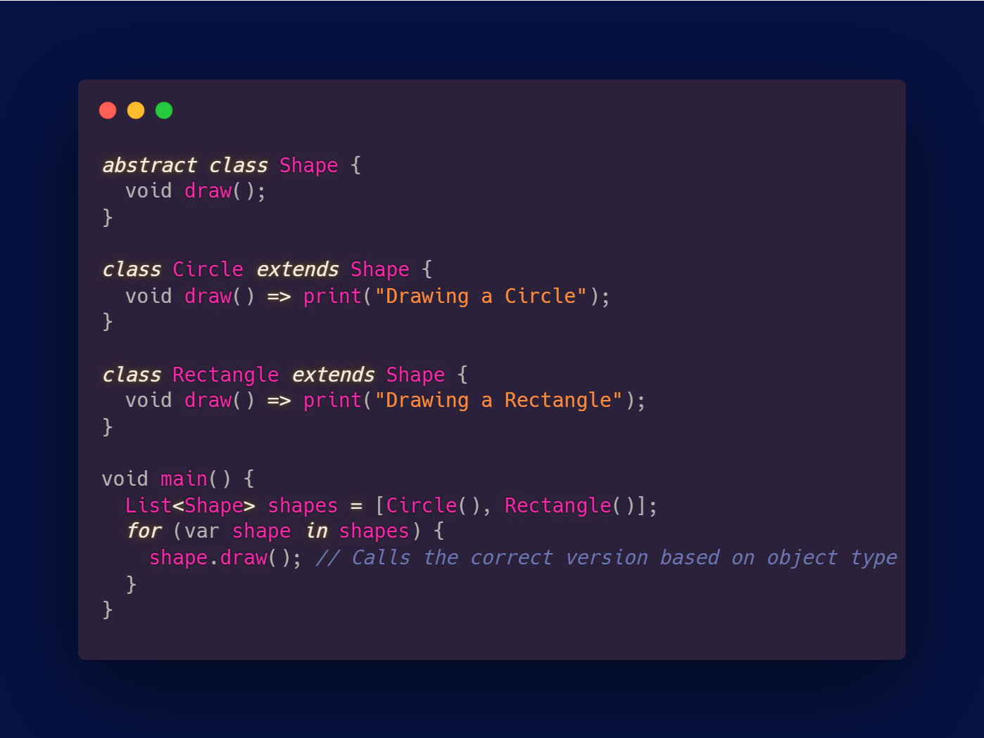
Polymorphism

Slide 25
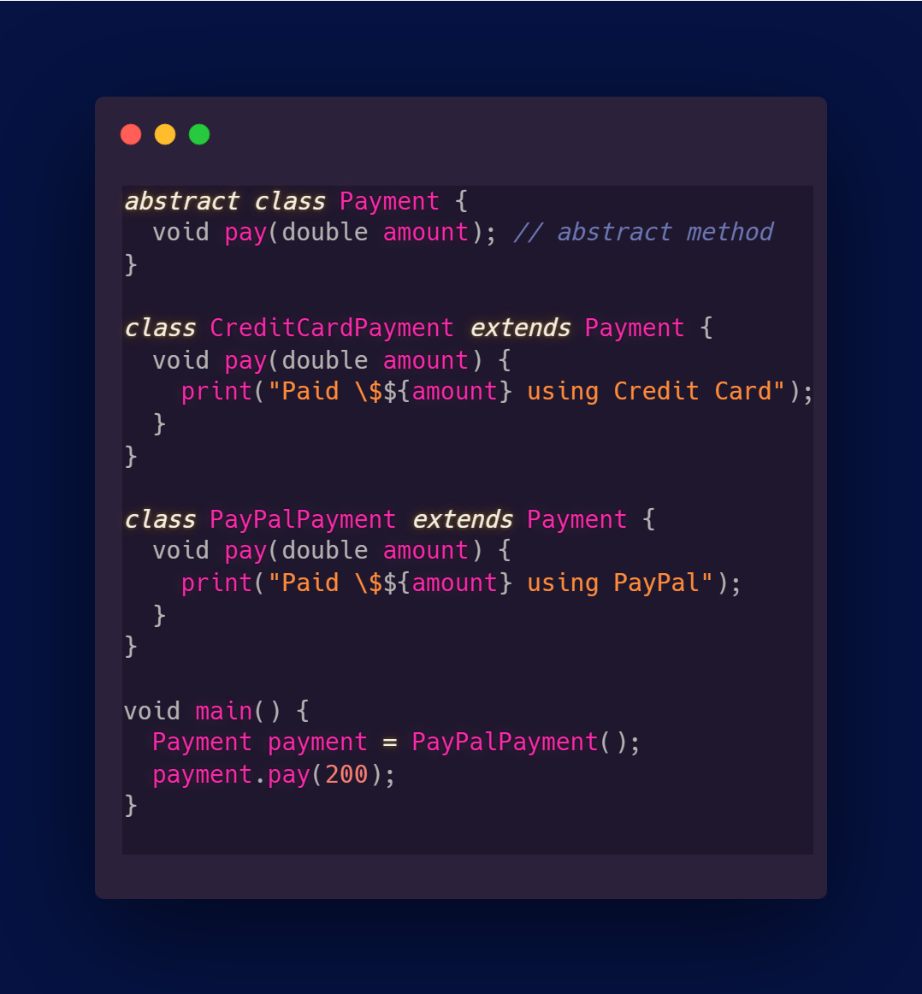
Abstraction

Slide 26
Thank you!

